Slide 1

MRDT Nav Board
Thomas Francois
Katherine Dunlap
Nithin Vijay

Slide 2
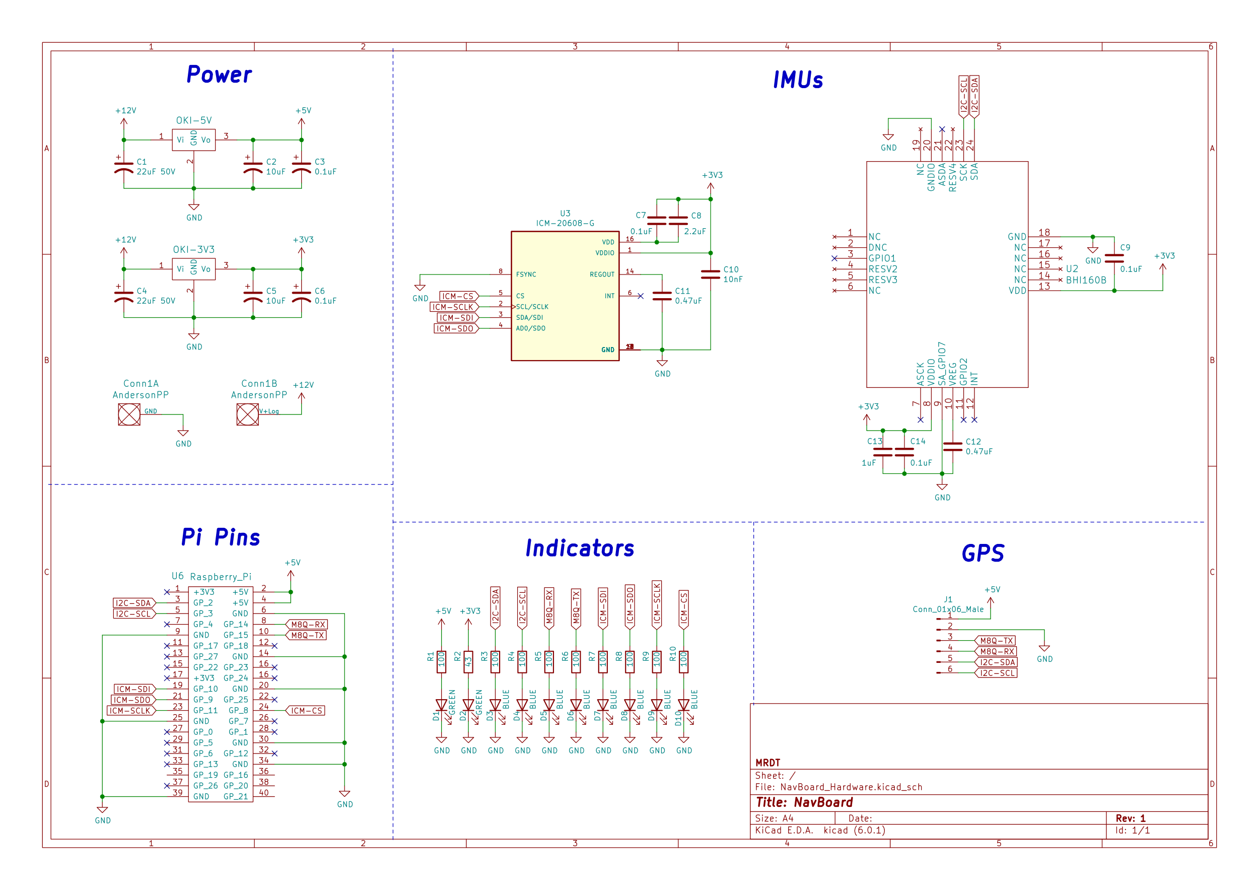
Old Schematic
Use of Global Labels
Dangerous Practice
Doesn’t Show Signal Flow
Incorrect Input For Raspberry Pi
Mislabeled GND (Pin 38)
No Page Information
Cluttered Accelerometer Symbols, Unnecessary NC Pins
LEDs Powered Directly Off Data Lines, Reducing Signal Integrity And Power
No Pull-Down Resistors On I2C Lines

Slide 3
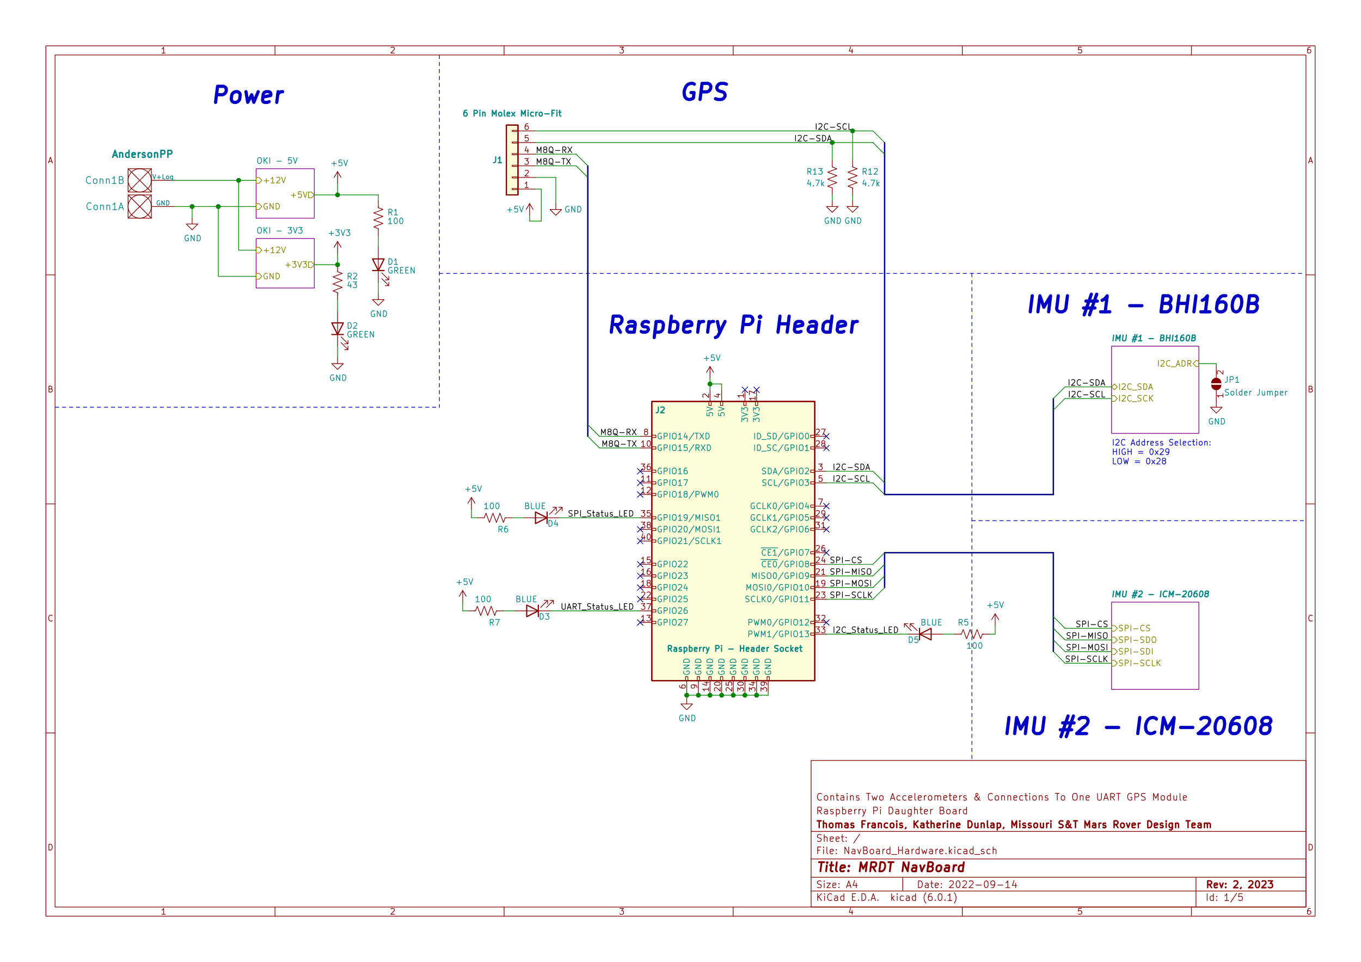
New Schematic
Moved IMUs And Voltage Regulators To Hierarchical Sheets
Improved Simplicity Of System Overview Page
Reduced Clutter, Improved Scalability
Used Official KiCAD Raspberry Pi Header Symbol, Improved Molex Symbol
Use Of Bus Lines for I2C, UART, and SPI
Improves Understanding Of System Data Flow
LEDs moved off data lines, connected directly to Raspberry Pi
Added Pull-Down Resistors To I2C
Added Page Information

Slide 4
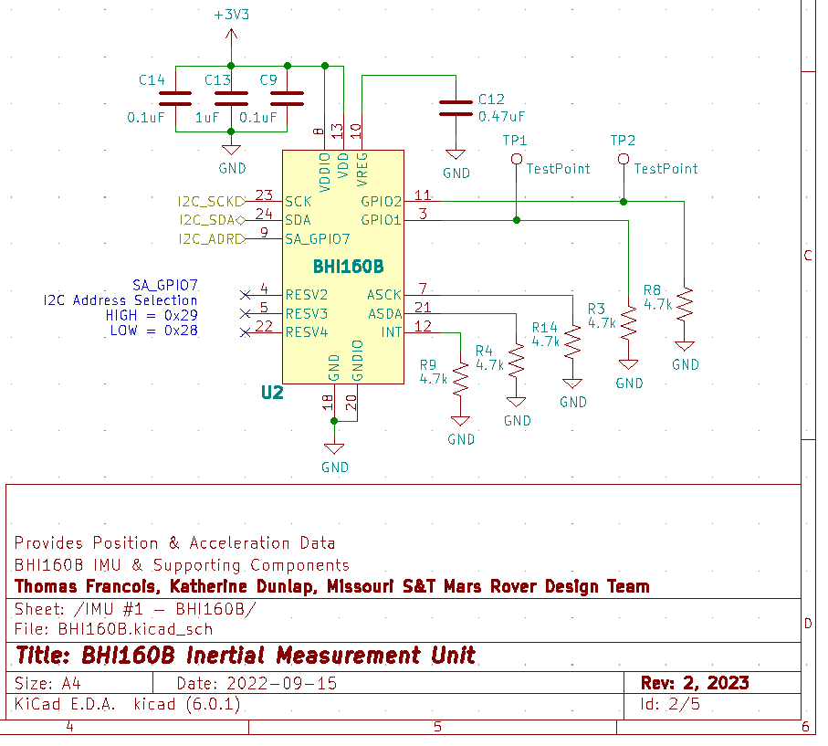
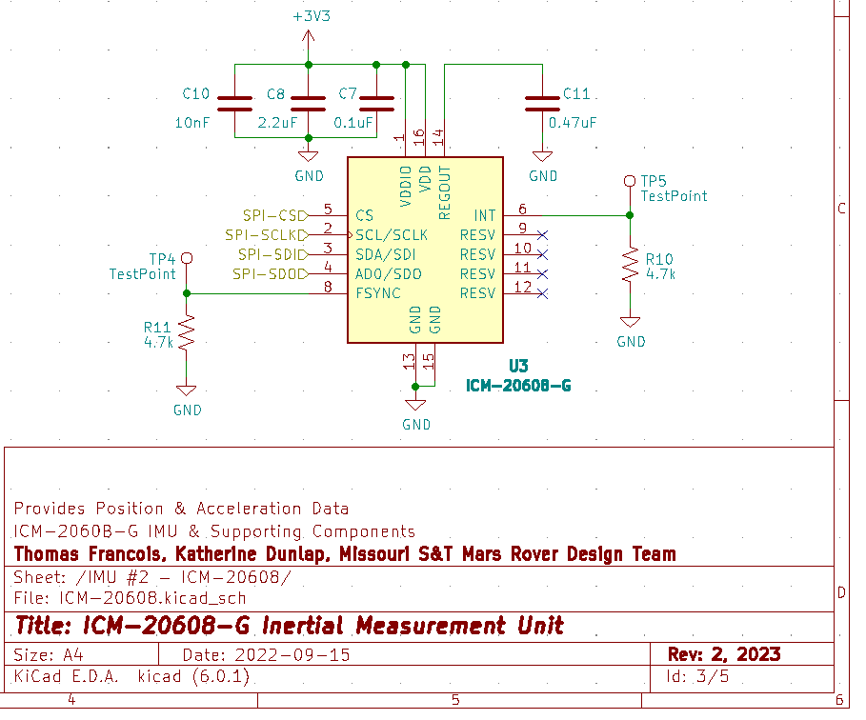
Accelerometer Component Sheets
Added Pull-Down Resistors To Unused Pins
Removed Do Not Connect Pins, Declutters Symbols
Added Test Points To GPIO and Interrupt Pins
For Future Debug, Easier Modification For Future Features

Slide 5
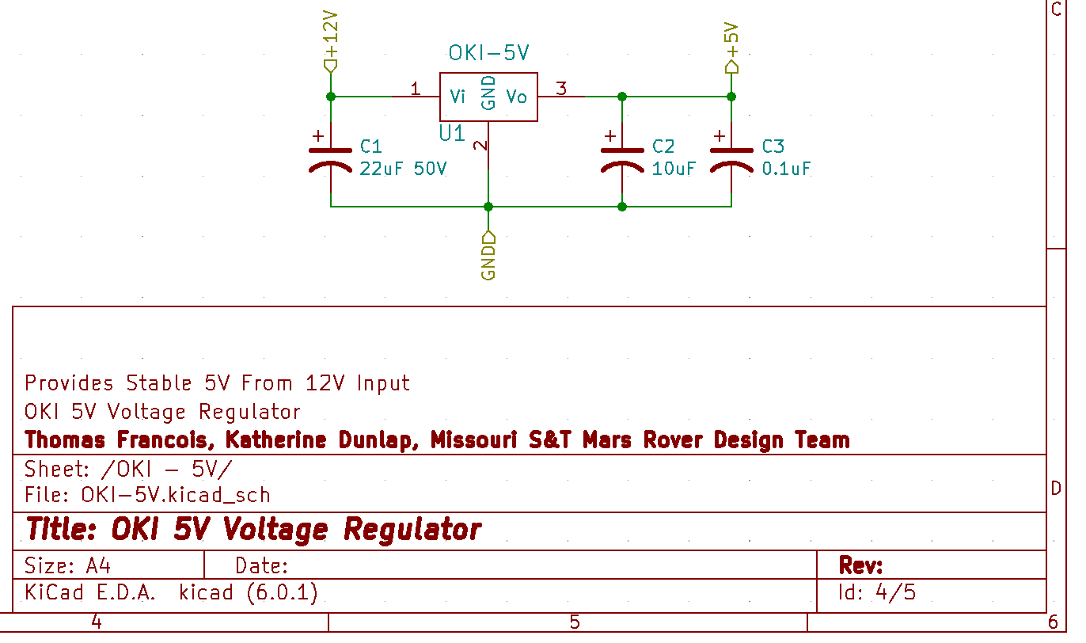
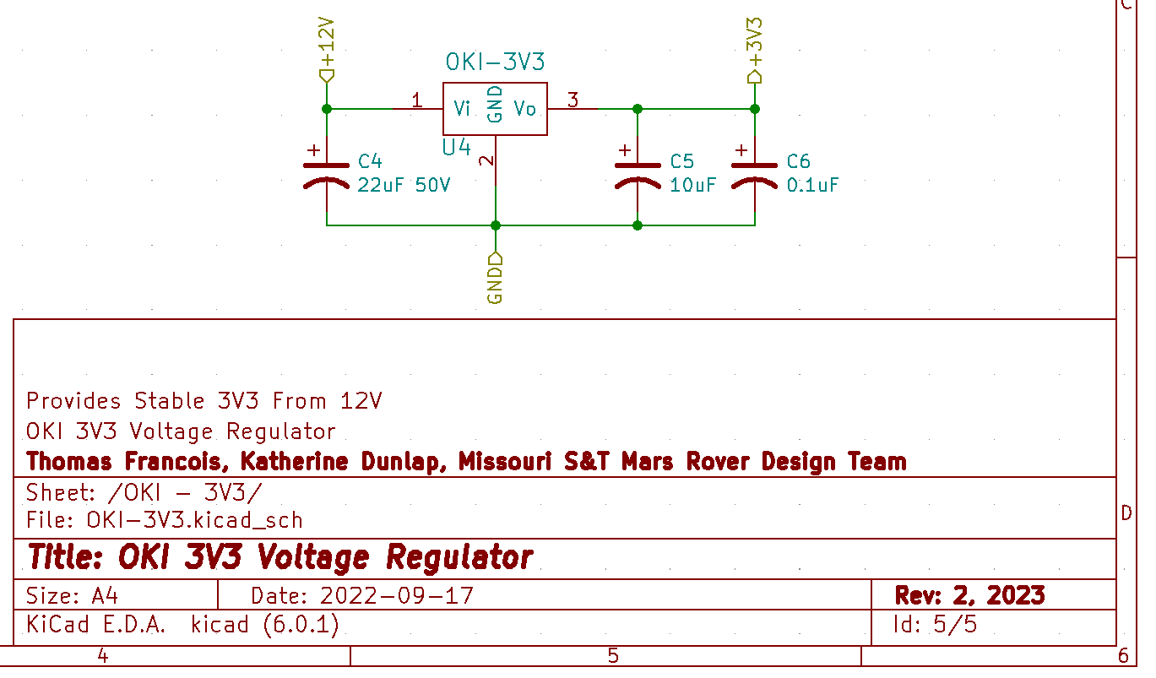
Voltage Regulator Component Sheets
Moved To Component Sheets For Simplicity Of Main Overview Page

Slide 6
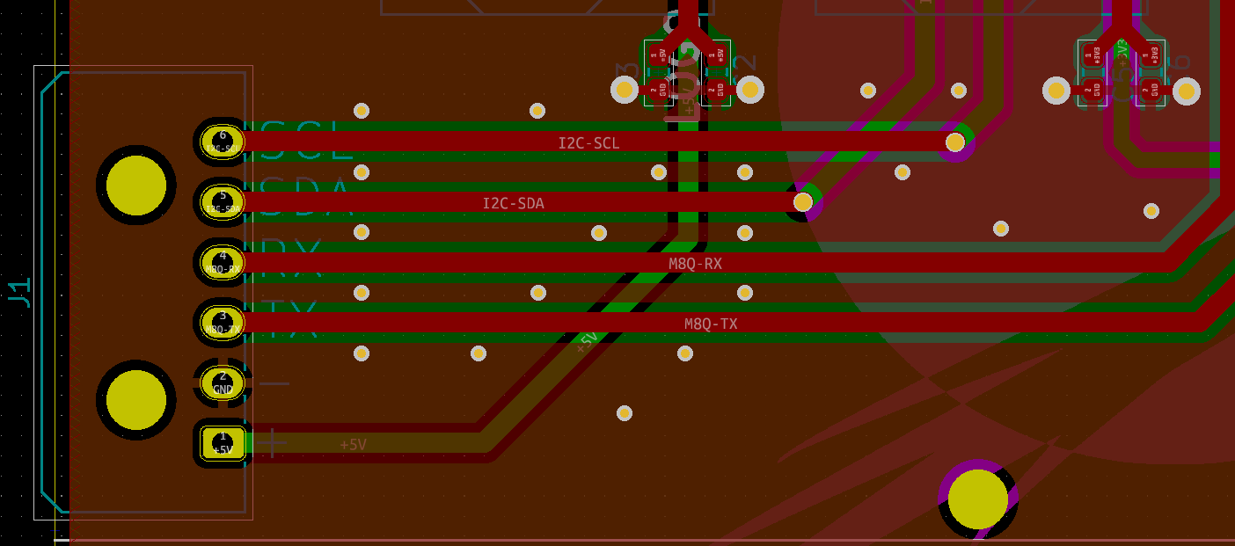
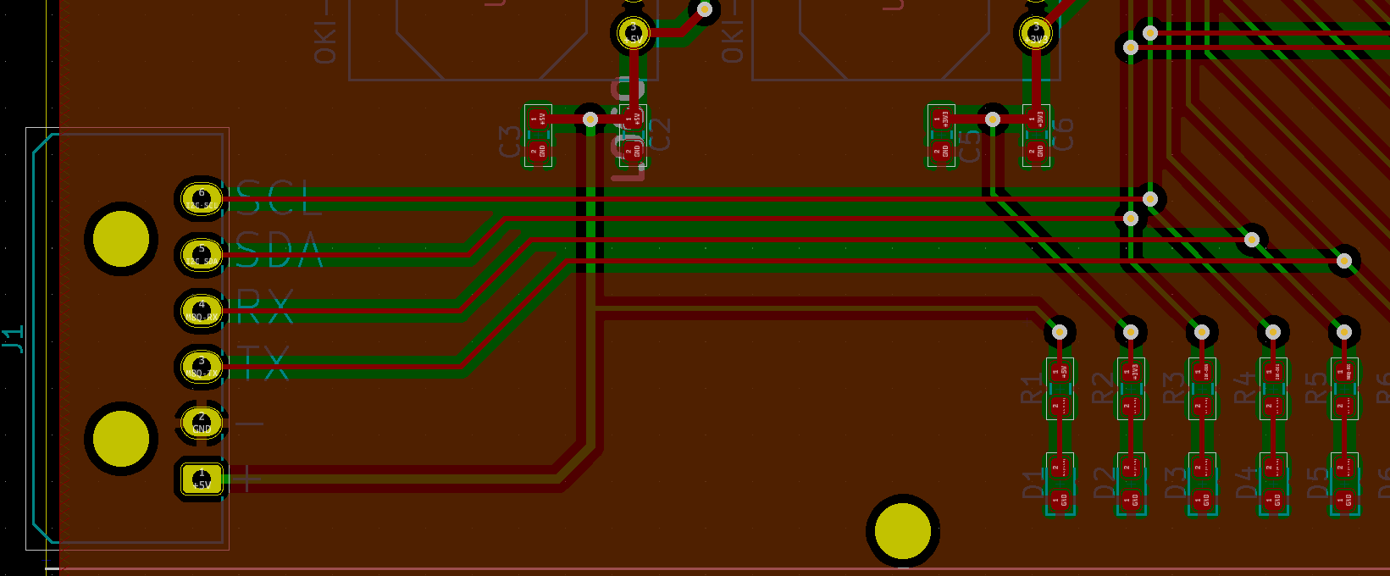
GPS I2C & UART Lines
Thicker Traces, Lower Resistance
Greater Spacing
Ground Plane Shielding Between Traces
Added Vias To Reduce Ground Impedance, Improved Shielding Inside Substrate
For Added Shielding:
UART Routed On Top Layer
I2C Routed On Bottom Layer
NEW
OLD

Slide 7
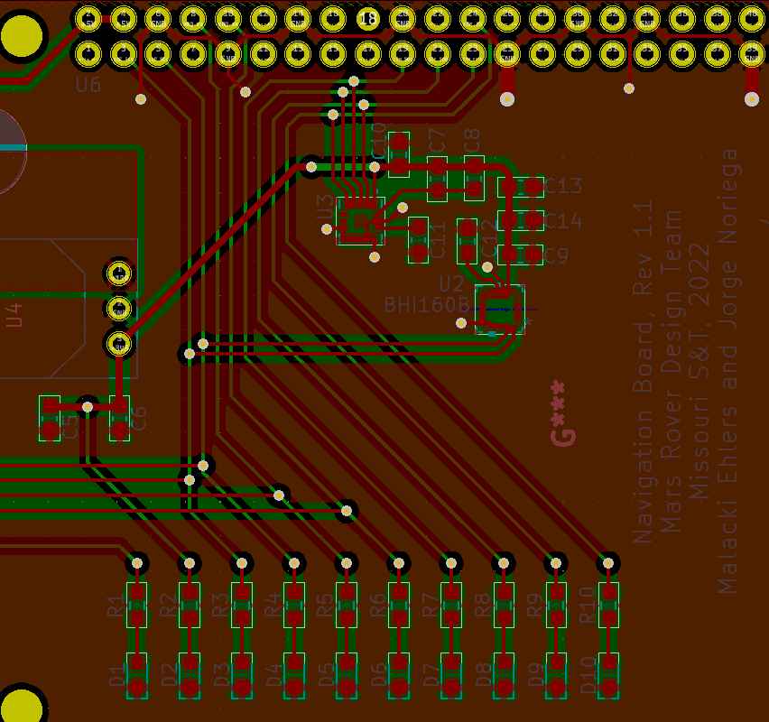
Old Accelerometer Layout
Decoupling Capacitors
Far from the chips
Located along common power line, reducing effectiveness
Unused Pins Are Left Floating
Including Interrupt Pin
SPI, I2C, And UART Lines
Cross over each other
Unnecessarily small and long
LEDs are powered directly off data lines, reducing signal integrity and power

Slide 8
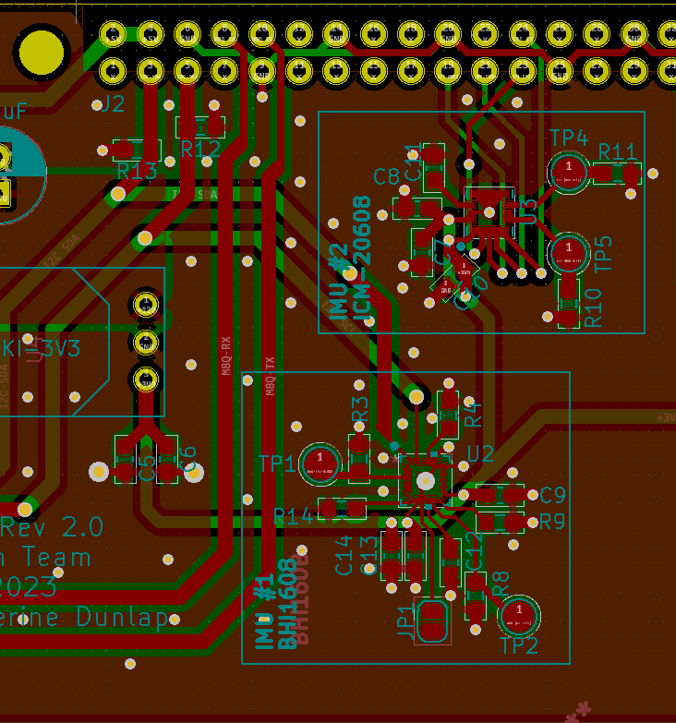
New Accelerometer Layout
Decoupling Capacitors
Closer to power pins
Individual 3V3 connections
Unused Pins Connected To Pulldown Resistors, Optional Pins Have Test Points
SPI and I2C lines
Do Not Cross, Not Even Nearby
Thicker Traces
Isolated With Ground Plane In Between Signals
Vias Added To Isolate From UART Lines
Added Vias To Add Shielding Inside Substrate
LEDs moved off data lines, connected directly to Raspberry Pi
Added Test Points To GPIO and Interrupt Pins

Slide 9
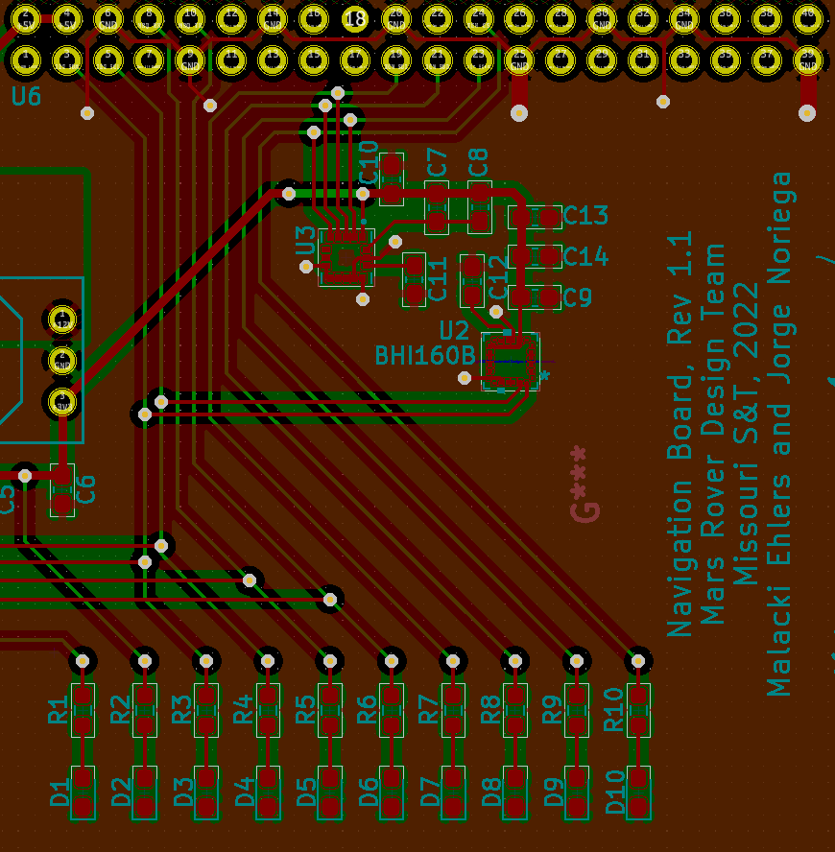
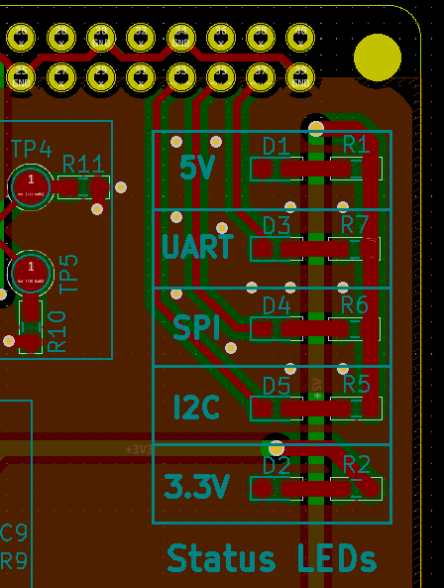
Improved LEDs
Moved off data lines, connected directly to Raspberry Pi
Will be controlled in software, just like Ethernet status LEDs
Labeled
Old Layout
New Layout

Slide 10
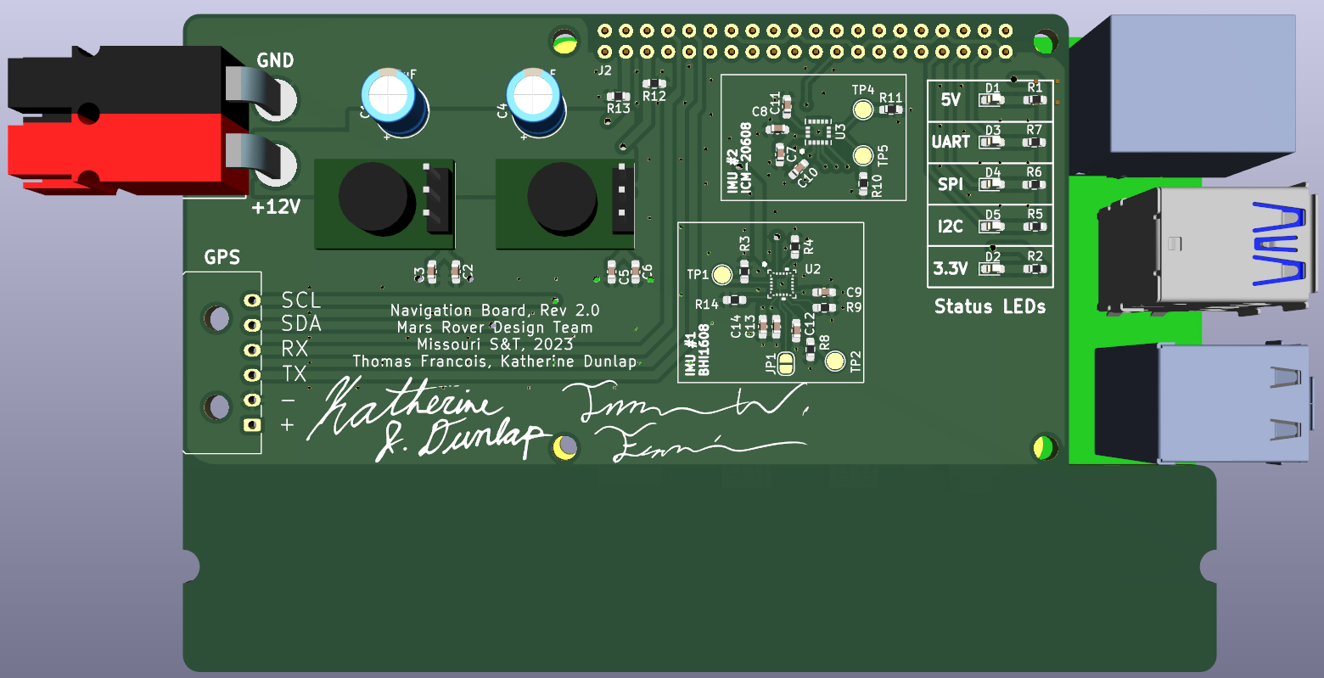
PCB Renderings

Slide 11
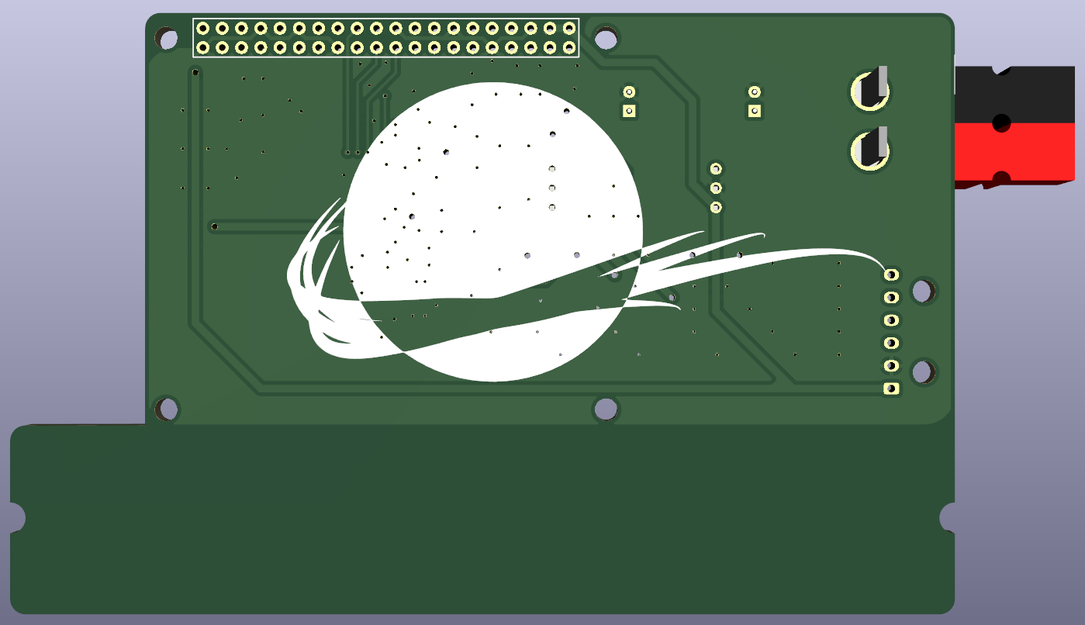
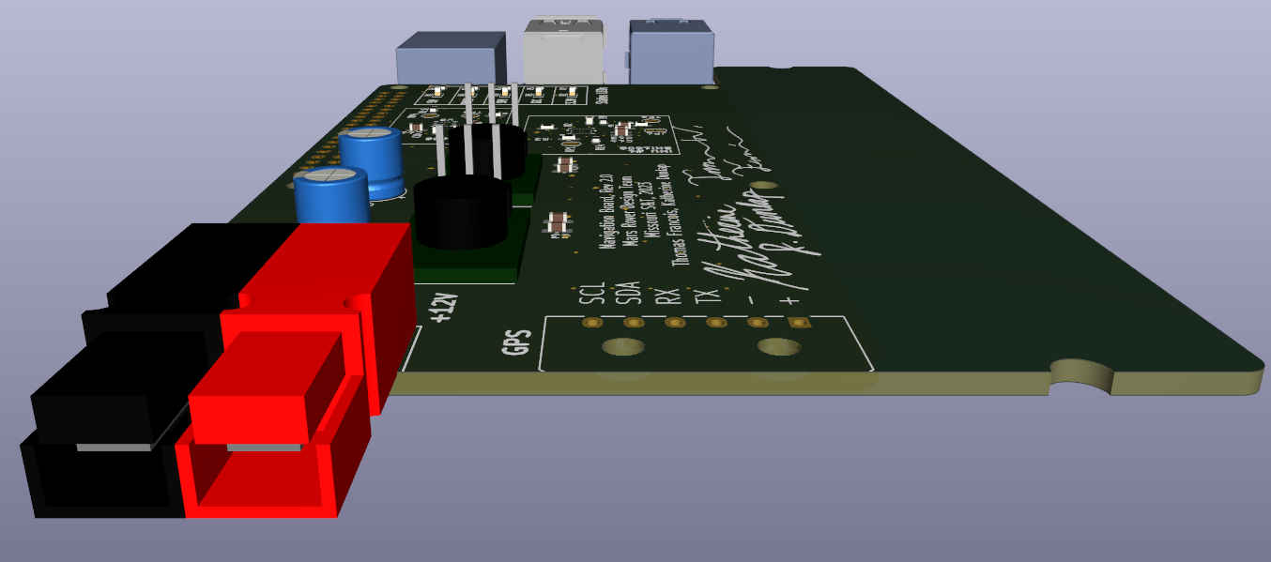
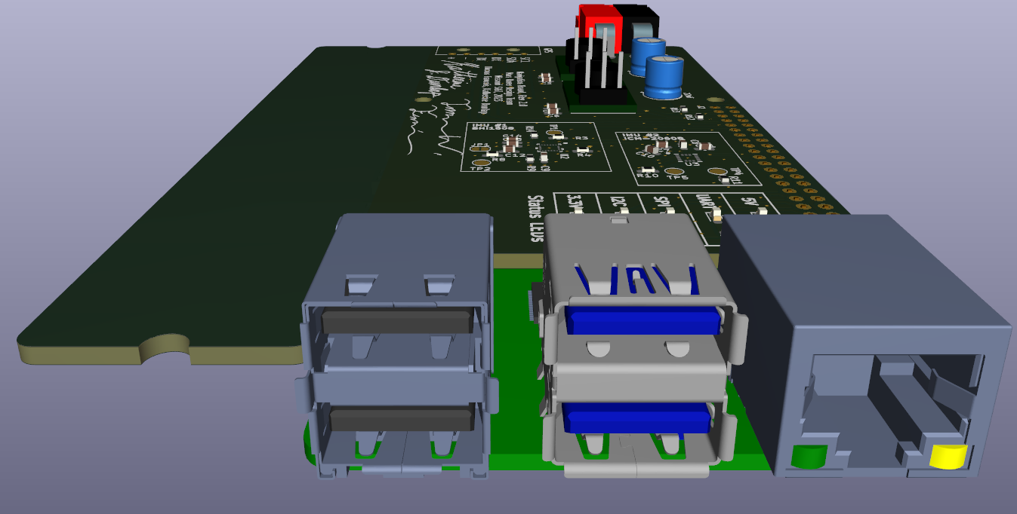
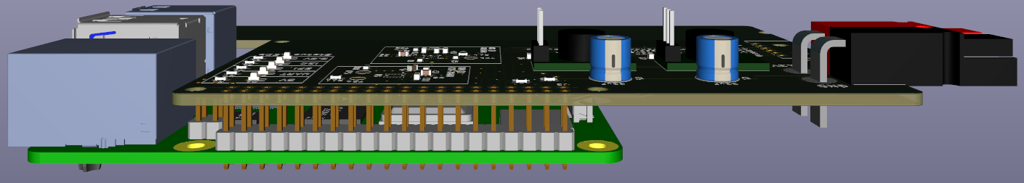

Slide 12
Bill Of Materials
Item | Qty | Reference(s) | Value | LibPart | Footprint
1 | 2 | C1, C4 | 22uF 50V | Device:C_Polarized_US | Capacitor_THT:CP_Radial_D6.3mm_P2.50mm
2 | 2 | C2, C5 | 10uF | Device:C_Polarized_US | Capacitor_SMD:C_0603_1608Metric_Pad1.08x0.95mm_HandSolder
3 | 2 | C3, C6 | 0.1uF | Device:C_Polarized_US | Capacitor_SMD:C_0603_1608Metric_Pad1.08x0.95mm_HandSolder
4 | 3 | C7, C9, C14 | 0.1uF | Device:C | Capacitor_SMD:C_0603_1608Metric_Pad1.08x0.95mm_HandSolder
5 | 1 | C8 | 2.2uF | Device:C | Capacitor_SMD:C_0603_1608Metric_Pad1.08x0.95mm_HandSolder
6 | 1 | C10 | 10nF | Device:C | Capacitor_SMD:C_0603_1608Metric_Pad1.08x0.95mm_HandSolder
7 | 2 | C11, C12 | 0.47uF | Device:C | Capacitor_SMD:C_0603_1608Metric_Pad1.08x0.95mm_HandSolder
8 | 1 | C13 | 1uF | Device:C | Capacitor_SMD:C_0603_1608Metric_Pad1.08x0.95mm_HandSolder
9 | 1 | Conn1 | AndersonPP | MRDT_Connectors:AndersonPP | MRDT_Connectors:Anderson_2_Horizontal_Side_by_Side
10 | 2 | D1, D2 | GREEN | Device:LED | LED_SMD:LED_0603_1608Metric_Pad1.05x0.95mm_HandSolder
11 | 3 | D3, D4, D5 | BLUE | Device:LED | LED_SMD:LED_0603_1608Metric_Pad1.05x0.95mm_HandSolder
12 | 1 | J1 | 6 Pin Molex Micro-Fit | Connector_Generic:Conn_01x06 | Connector_Molex:Molex_Micro-Fit_3.0_43650-0600_1x06_P3.00mm_Horizontal
13 | 1 | J2 | Raspberry Pi - Header Socket | Connector:Raspberry_Pi_2_3 | MRDT_Shields:RaspberryPi_THT_BOTTOM
14 | 1 | JP1 | Solder Jumper | Jumper:SolderJumper_2_Open | Jumper:SolderJumper-2_P1.3mm_Open_RoundedPad1.0x1.5mm
15 | 4 | R1, R5, R6, R7 | 100 | Device:R_US | Resistor_SMD:R_0603_1608Metric_Pad0.98x0.95mm_HandSolder
16 | 1 | R2 | 43 | Device:R_US | Resistor_SMD:R_0603_1608Metric_Pad0.98x0.95mm_HandSolder
17 | 9 | R3, R4, R8, R9, R10, R11, R12, R13, R14 | 4.7k | Device:R_US | Resistor_SMD:R_0603_1608Metric_Pad0.98x0.95mm_HandSolder
18 | 4 | TP1, TP2, TP4, TP5 | TestPoint | Connector:TestPoint | TestPoint:TestPoint_Pad_D2.0mm
19 | 1 | U1 | OKI-5V | MRDT_Devices:OKI | MRDT_Devices:OKI_Horizontal
20 | 1 | U2 | BHI160B | MRDT_Sensors:BHI160B | BHI160B:BHI160B
21 | 1 | U3 | ICM-20608-G | MRDT_Sensors:ICM-20608-G | ICM-20608-G:ICM-20608-G
22 | 1 | U4 | OKI-3V3 | MRDT_Devices:OKI | MRDT_Devices:OKI_Horizontal
39 Components
45 Listed, But Test Points, Solder Jumpers, and Raspberry Pi Pins Don’t Count
Same components from previous board, all can be salvaged for $0
BOM is same from previous board, consult previous documentation to order new components

